Slide 1
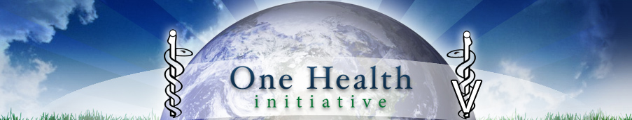

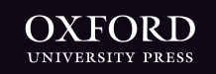
One Health for Life
JOINT THEMATIC ISSUE CALL FOR PAPERS
FEMS Microbiology Ecology and Pathogens and Disease
The health of humans is inextricably linked to the health of other living creatures and to the health of the environment. This is perhaps best illustrated by infectious disease microorganisms, many of which ‘evolve’ in animals and/or the environment and at various times during evolution find a niche in humans.
We welcome all article types, including Research Articles, Mini Reviews, Short Communications, Perspectives, Commentaries, and Shortomics. Authors should specify ‘OneHealth’ in their cover letter to either journal. All submitted papers will undergo independent peer-review. Upon publication of these articles, a virtual joint thematic issue will bring together articles from both titles and will be promoted by FEMS and their publisher, Oxford University Press.
http://bit.ly/29DbjsQ
Notes:
Forthcoming call for papers

